Slide 1
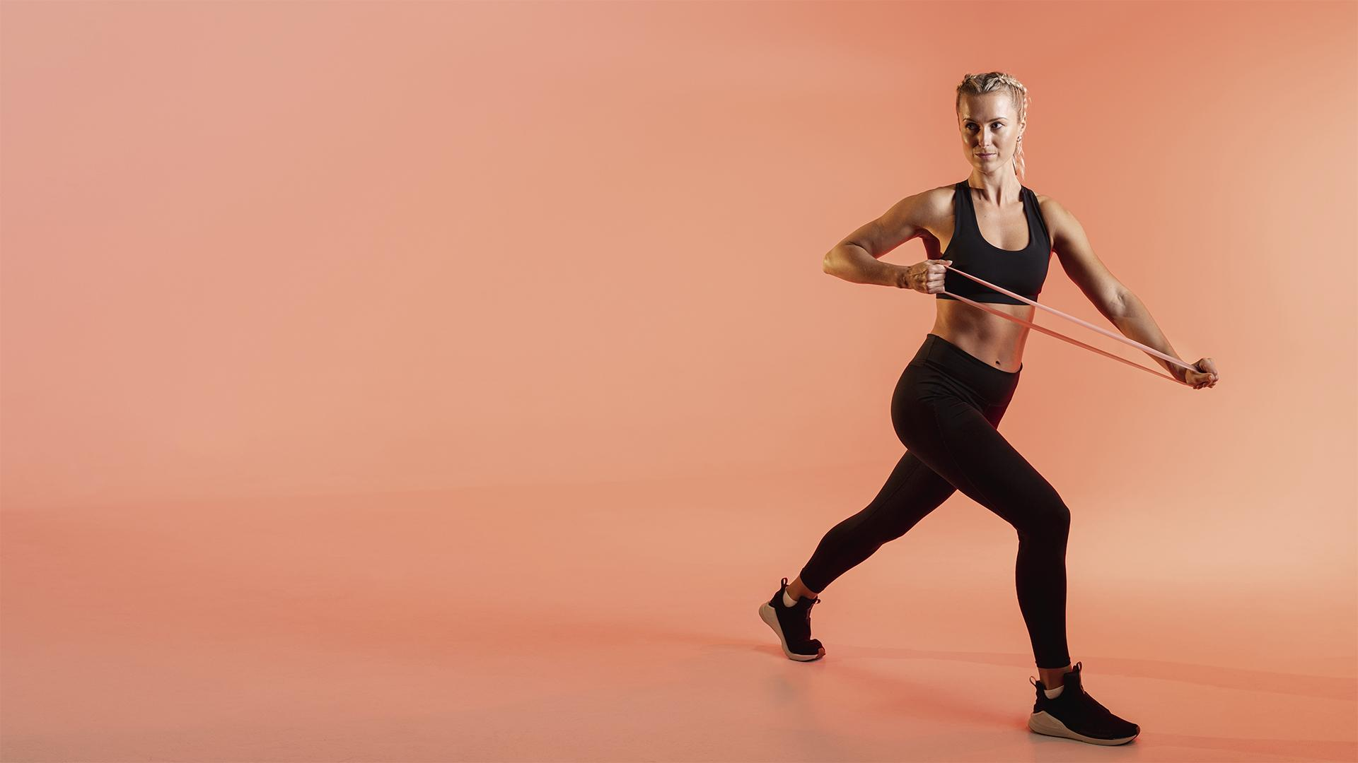
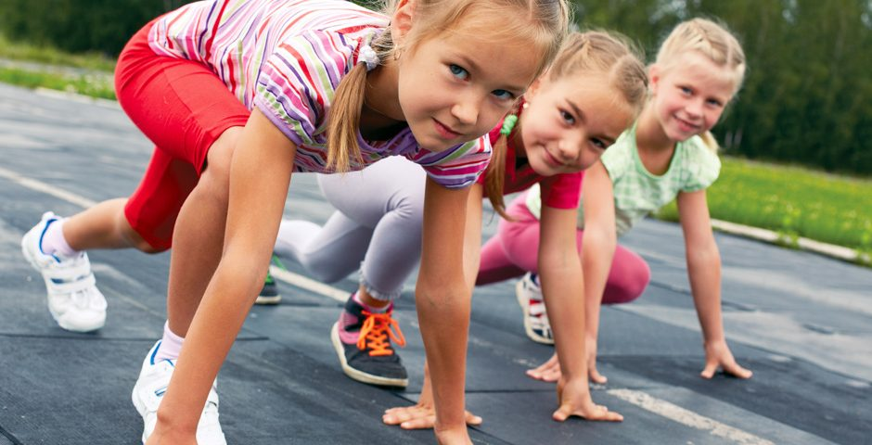
FITNESS APP
Motoric skills development
Made by:
Lisa Dumaij 19049838
Yuliya Litvin 20161417
Mustafa Mousa 18068987
Pascal Seegers 21132844
Joost van Viegen 18048757
Joep van der Zanden 19134282
Here is where your pitch deck begins

Slide 2
What we have done
01
Compared T0 and T1 data
Merged all-in to one dataset
Cleaned the dataset
Different variants of imputation
Wrote an evaluation plan

Slide 3
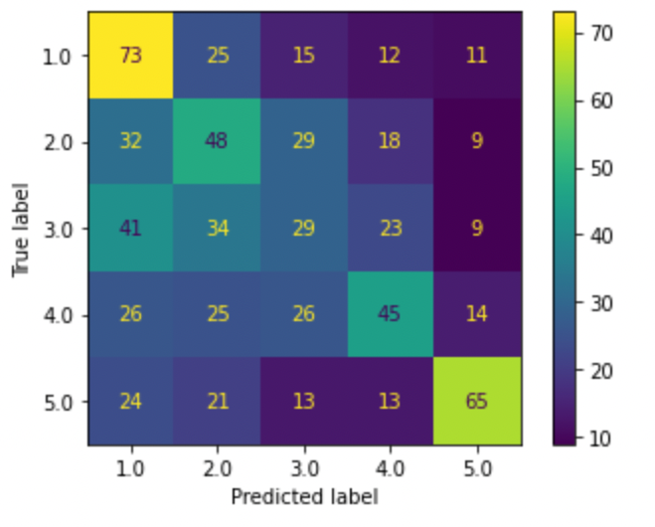
Evaluation plan

Slide 4
02 Next steps
Contact Pim
Handle outliers
Imputation
External presentation
Notes:
We have received the T0 data, but we are still waiting for the T1.
The data files we received have been combined into a single file.
We have explored the data using multiple visualisations

Slide 5
03 Doubts
“How can data science be used to predict whether a child has a chance of developing a lack in motor skills at a later age?”

Slide 6
THANK YOU!

